Slide 1

Enhancing Customer Engagement and Reducing Churn:
Data-Driven Solutions and Prediction for Telecommunication Success
by Aruci Team

Slide 2



Our Team
Aruci | DSW 2023
Sulaiman
Bilal
Industrial Engineering
UNS
Dendy
Halim
Industrial Engineering
UNS
Akhdan
Hanif
Industrial Engineering
UNS

Slide 3

Background
Aruci | DSW 2023
The telecommunications industry plays a pivotal role in modern society, connecting people, enabling communication, and providing access to a multitude of services. As technological advancements continue, the importance of telecommunications companies in our daily lives has only increased.

Slide 4
Challenges
Aruci | DSW 2023
Churn Rate
Engagement
Customer Spending
The rate at which customers leave the company is alarmingly high.
Some customers are not actively using additional services, impacting revenue and customer experience
The fluctuation in customer spending per month makes it challenging to predict revenue and allocate resources effectively.
Call Center Utilization
Customer Behavior
The limited utilization of call center services might be a sign of unaddressed customer issues.
It's crucial to understand what drives customer retention and engagement to tailor services accordingly.

Slide 5



Importances
Aruci | DSW 2023
Risk Management
Profitability Focus
Data-Driven Approach
The urgency of addressing these issues cannot be overstated. Failure to do so can result in severe financial losses, a damaged reputation, and ultimately, the inability to compete in a highly competitive industry.
. The importance of optimizing customer engagement and reducing churn rate is evident. It directly impacts a company's bottom line and its ability to thrive in a rapidly evolving market.
In an age of data and analytics, companies have the opportunity to leverage insights from their data to tackle these challenges head-on, ultimately improving customer satisfaction and their own long-term sustainability.

Slide 6
Aruci | DSW 2023
Data & Methodology
The dataset shows the usage of telecommunication services in Q3 of a particular year adapted from a Kaggle public dataset with several modifications. There are several columns provided in the dataset:

Slide 7
Aruci | DSW 2023
Data & Methodology
Exploratory Data Analysis
Feature Selection
XGBoost Modeling
Conducted EDA to gain insights into the dataset's characteristics and relationships.
Determine which features would be most relevant for our analysis.
Implemented XGBoost, a powerful ensemble learning technique, to predict and analyze customer behavior, encompassing factors like churn rate and customer spending.
Recommendation
Evaluation & Interpretation
Based on our findings, we made data-driven recommendations for the telecommunication company.
Evaluated the model's performance and interpreted the results to extract valuable insights.

Slide 8
Data & Methodology :
Aruci | DSW 2023
Data Exploratory
Checking Missing Values
Examine the dataset to identify any missing values in columns.
Checking Duplicates
Inspect the dataset for duplicate rows and take appropriate action, such as removing duplicates, to maintain data integrity
Checking Outliers
Analyze the dataset for the presence of outliers in numerical variables. Determine whether to address outliers through transformations, imputation, or removal, depending on the nature of the data.
Changing Categorical Variables to Numeric
Convert categorical variables into a numeric format suitable for modeling. This may involve techniques such as one-hot encoding, label encoding, or using techniques specific to the algorithm being used.

Slide 9
Data & Methodology :
Aruci | DSW 2023
Data Exploratory
Counting Rows & Columns
Count the number of rows and columns in the dataset.
Checking Structure
Examine the structure of the dataset to review data types and identify any data errors.
Checking Unique Value
Inspect the unique values in each column to understand the diversity of the data.
Data Visualization
General Churn Visualization
Customer Distribution Visualization
Customer-to-Churn Distribution Visualization
Customer Lifetime in Service to Churn Visualization
Monthly Charges to Churn Visualization
Payment Method to Churn Visualization
Correlation between variables
etc.

Slide 10
Data & Methodology :
Aruci | DSW 2023
Feature Selection
Correlation analysis
Perform correlation analysis to identify highly correlated features and mitigate multicollinearity. High correlation between features can affect the performance of certain models, including linear models. Consider removing one of the highly correlated features to improve model interpretability and stability.
Dropping columns
Remove unnecessary columns from the dataset:
Customer ID
Latitude
Longitude
Location
CLTV

Slide 11
Data & Methodology :
Aruci | DSW 2023
XGBoost Modeling
Data Splitting
Divide the dataset into training and testing sets into 80-20 ratio.
Feature Scaling
Standardize or normalize the numerical features in the dataset.
Data Balancing
Assess and address class imbalance in the target variable (churn). If there is a significant imbalance between the number of churn and non-churn instances.
Validation Model
Implement a validation strategy to fine-tune hyperparameters and assess model performance:

Slide 12









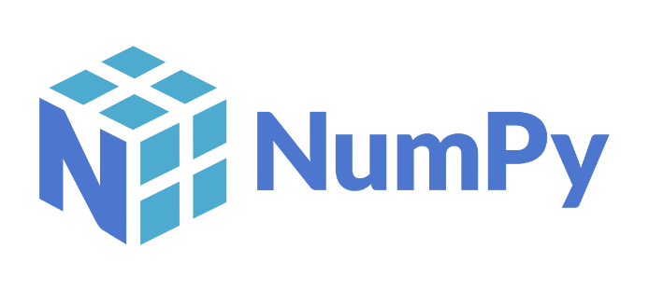
Aruci | DSW 2023
Tools Used

Slide 13
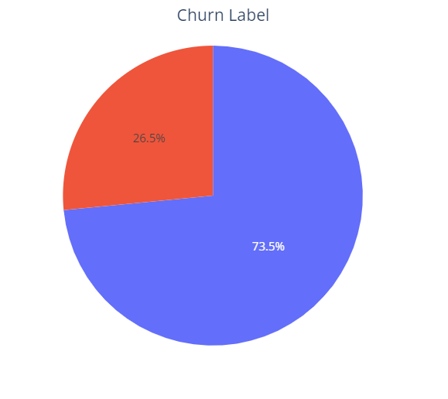

Aruci | DSW 2023
Result
Churn Rate Insights
A total of 1869 customers churned and 5174 did not churn.

Slide 14
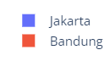
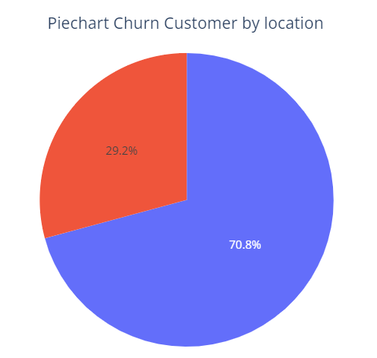
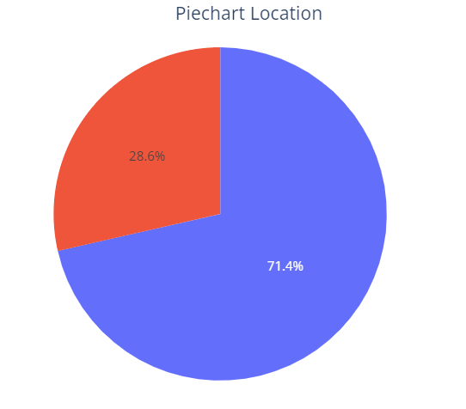
Aruci | DSW 2023
Result
Churn Rate Insights by location
Most customers come from the Jakarta area with the number of customers = 5031 (71.4%) While in Bandung, the number of customers amounted to = 2012 (28.6%)
Most customers who churn are in the Jakarta location as many as 1323 customers and the rest in Bandung as many as 546 customers.

Slide 15
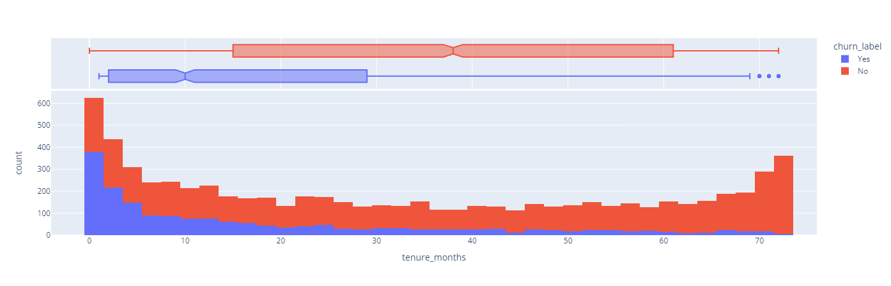
Aruci | DSW 2023
Result
Churn Rate Insights based on Customer Tenure
We identified that customer tenure (the length of time a customer has been with the company) has a significant impact on churn rate. Longer-tenured customers are less likely to churn, highlighting the importance of customer retention efforts.

Slide 16
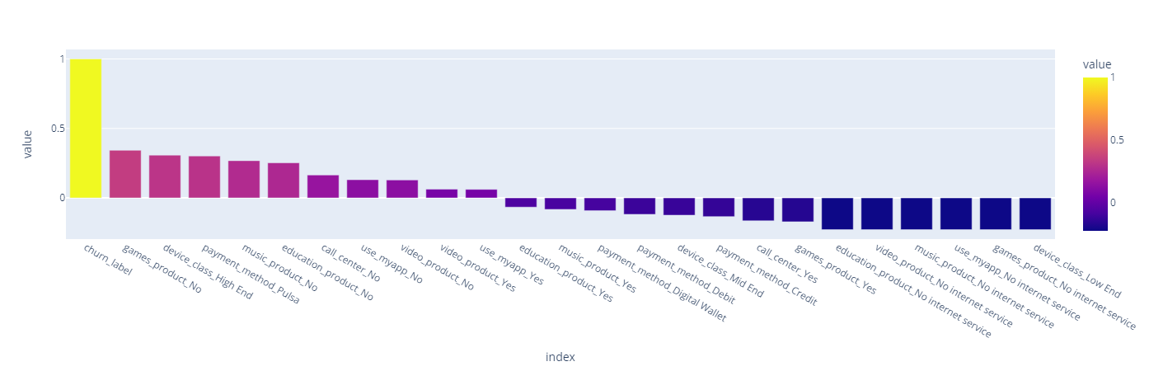
Aruci | DSW 2023
Result
Service Usage
Customers who use services such as Call center, myApps, Games, Music, Education, and Video Products are more likely to stay with the company. This suggests that these services play a vital role in retaining customers.

Slide 17
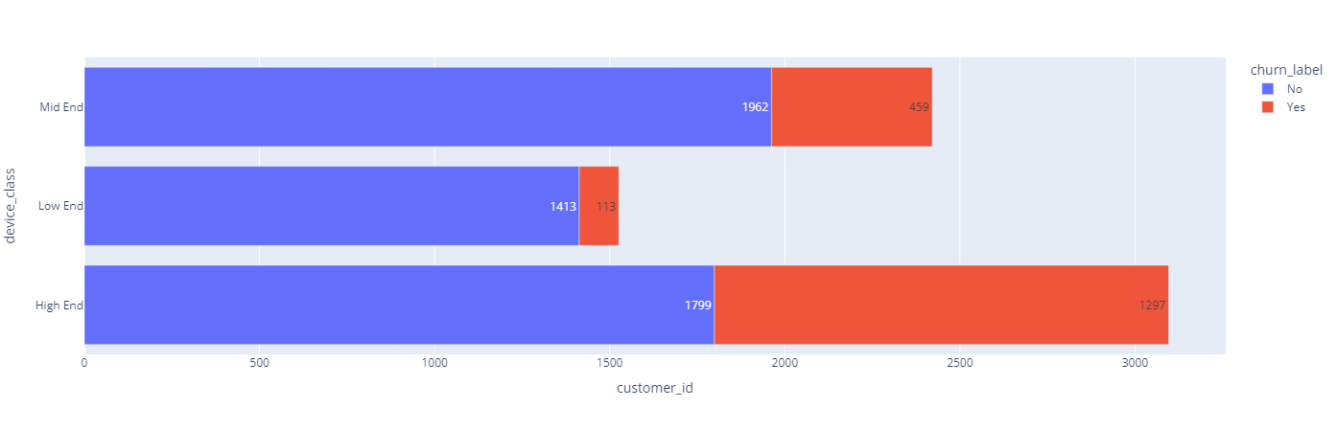
Aruci | DSW 2023
Result
User Device Classes
Customers who use high-end device are more likely to churn from the company.

Slide 18
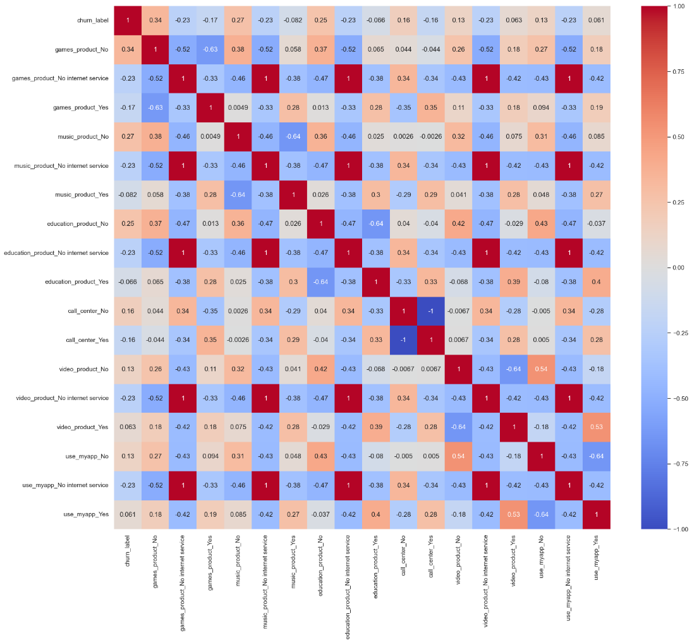
Aruci | DSW 2023
Result
Product Heatmap Correlation
Customer churn is mostly related to customer who didn’t use games product service.

Slide 19
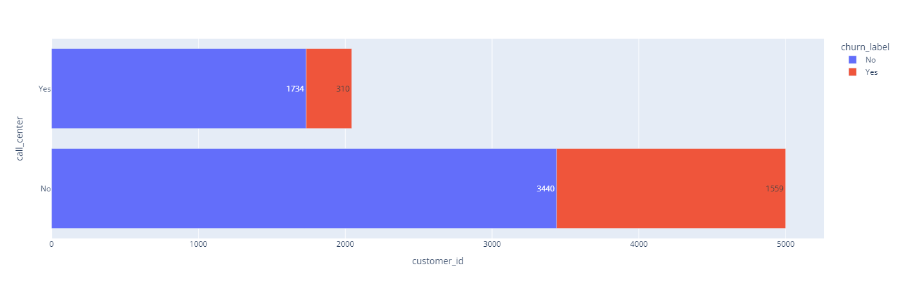
Aruci | DSW 2023
Result
Call Center Engagement
An increase in the utilization of call center services is linked to higher customer retention, emphasizing the importance of providing effective customer support.

Slide 20
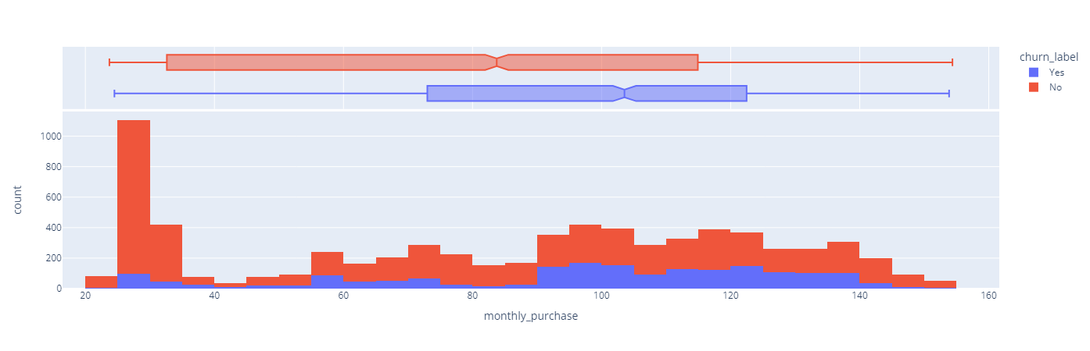
Aruci | DSW 2023
Result
Monthly Spending
Monthly spending by customers varies, impacting revenue. Those with higher spending are less likely to churn.

Slide 21
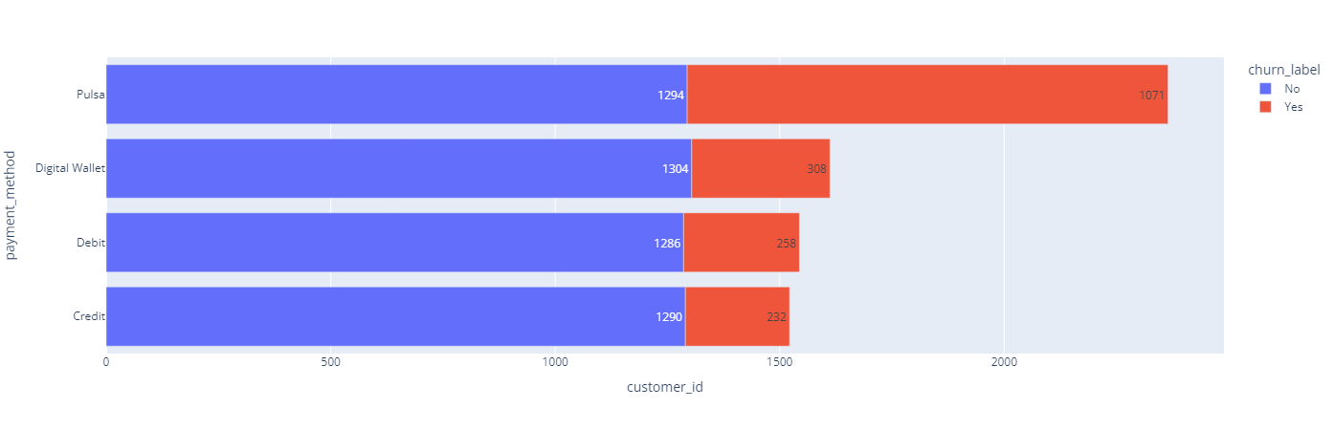
Aruci | DSW 2023
Result
Customer Payment Method
Most customers who churn are customers who use the credit payment method.

Slide 22
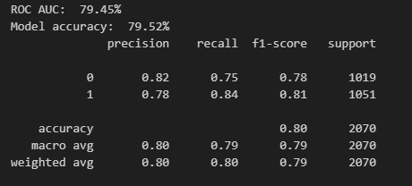
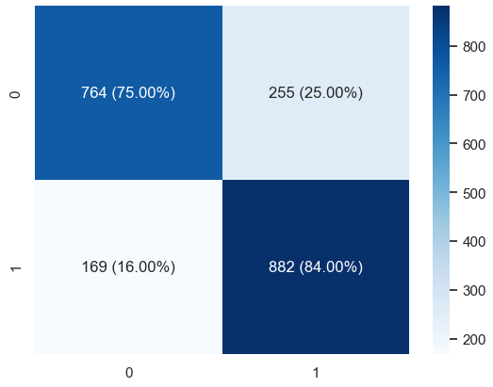
Aruci | DSW 2023
Result
XGBoost Model Evaluation
In summary, the model shows reasonably good performance with balanced precision and recall for both classes.
Business Interpretation: Each factor contributes to the prediction of churn and whether the model aligns with business intuition. Certain behaviour, products, or services (games_product, music_product, video_product, etc.) have a higher impact on churn, it may inform targeted retention strategies.

Slide 23

Aruci | DSW 2023
General Conclusion
The findings from our analysis have provided valuable insights into customer behavior within the telecommunications industry.
By understanding the key drivers of customer retention and engagement, the company can make informed decisions to optimize its strategies.
We recommend that the company focus on customer retention efforts, enhance customer support, and further develop its services to increase customer engagement.

Slide 24
Conclusion & Solution
Aruci | DSW 2023
Based on device class, high-end devices have more potential to leave the company.
Solution
The company is advised to provide more attractive offers to high-end deivce users

Slide 25
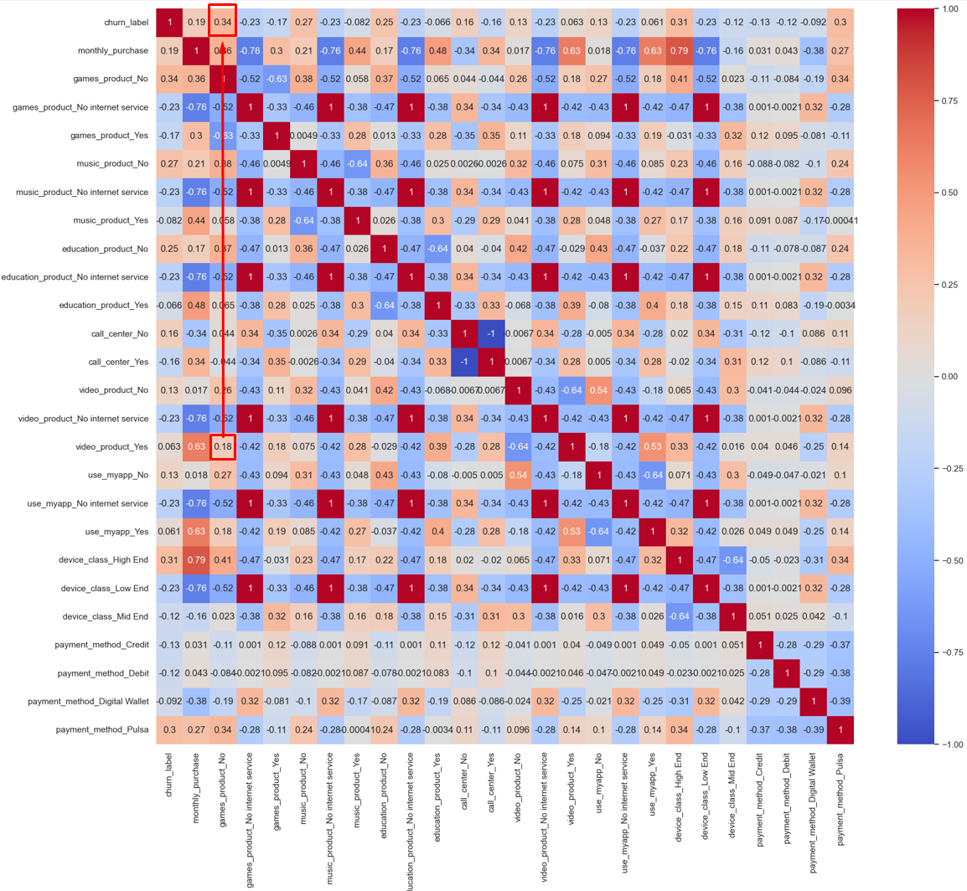
Conclusion & Solution
Aruci | DSW 2023
Some variables has its correlation with others, one of the example is the relationship between users of video service products and non-users of game services has a positive correlation
But, users of video service does have high correlation to video product
Solution
Provides bundling packages for video service users with additional gaming packages

Slide 26
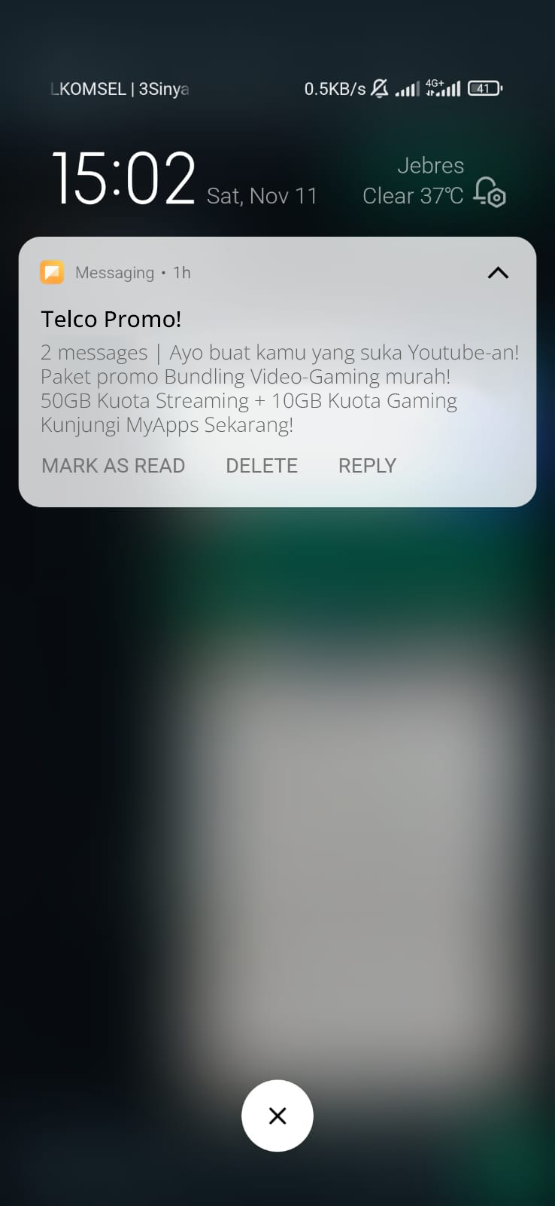
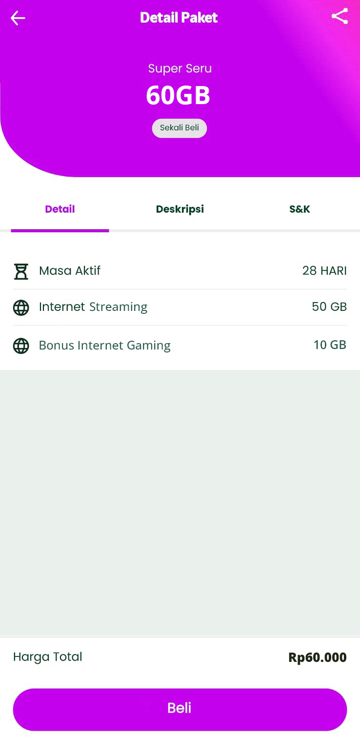
Conclusion & Solution
Aruci | DSW 2023
Example of a package bundling promotion

Slide 27
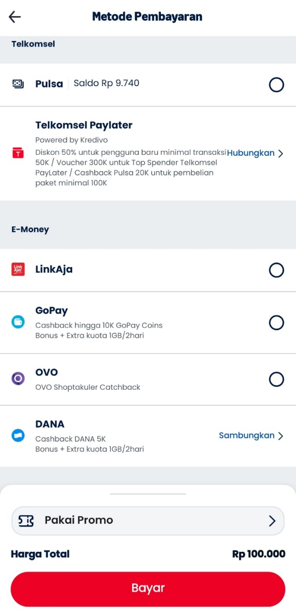
Conclusion & Solution
Aruci | DSW 2023
Payment with pulsa are not efficient for payment because of the flexibility. Pulsa usually only used for payment in the telecommunication company, so the user is reluctant to top up their balance and auto-monthly payment aren’t sustained.
Solution
Provide advantages for users to switch from pulsa payment to digital wallet, debit, or credit.

Slide 28
Conclusion & Solution
Aruci | DSW 2023
New customers are likely to leave due to their behavior of testing the service against their convenience.
Solution
Provide more advantages for new user below 5 month of tenure.

Slide 29
Conclusion & Solution
Aruci | DSW 2023
The churn rate for customers who use a call center is smaller than those who don't use a call center.
Solution
Providing offers through the call center to customers so that customers are more accustomed and not stiff when consulting with the call center

Slide 30
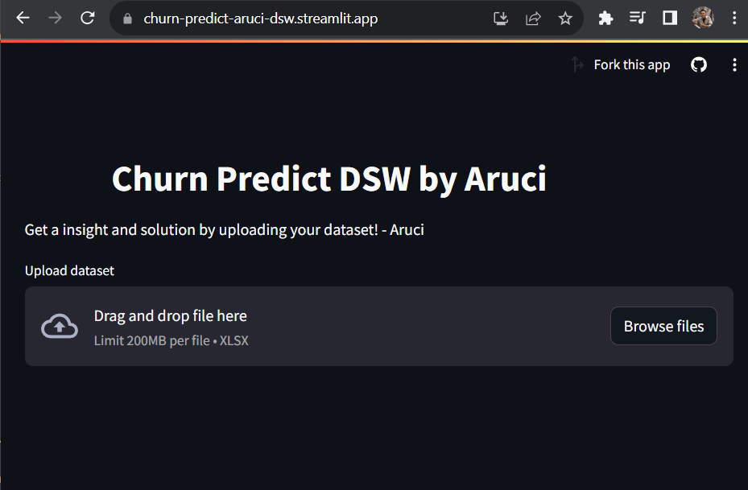
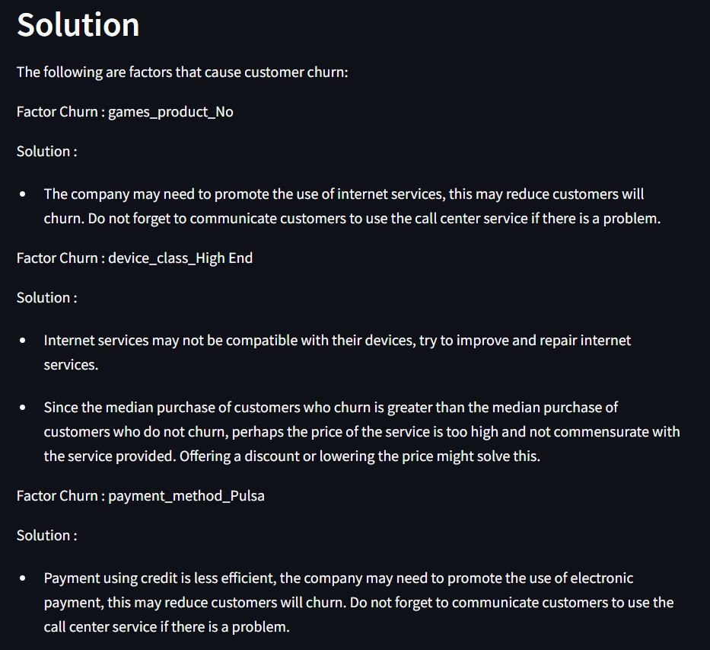
Conclusion & Solution
Aruci | DSW 2023
Based on Machine learning that have been made, it could be implemented as prediction model for company to predict new customer churn potential
Explore the power of our churn prediction model by visiting our dynamic website at https://churn-predict-aruci-dsw.streamlit.app/
(use Telco_customer_churn_adapted_v2 dataset)

Slide 31
Thankyou

